Slide 1
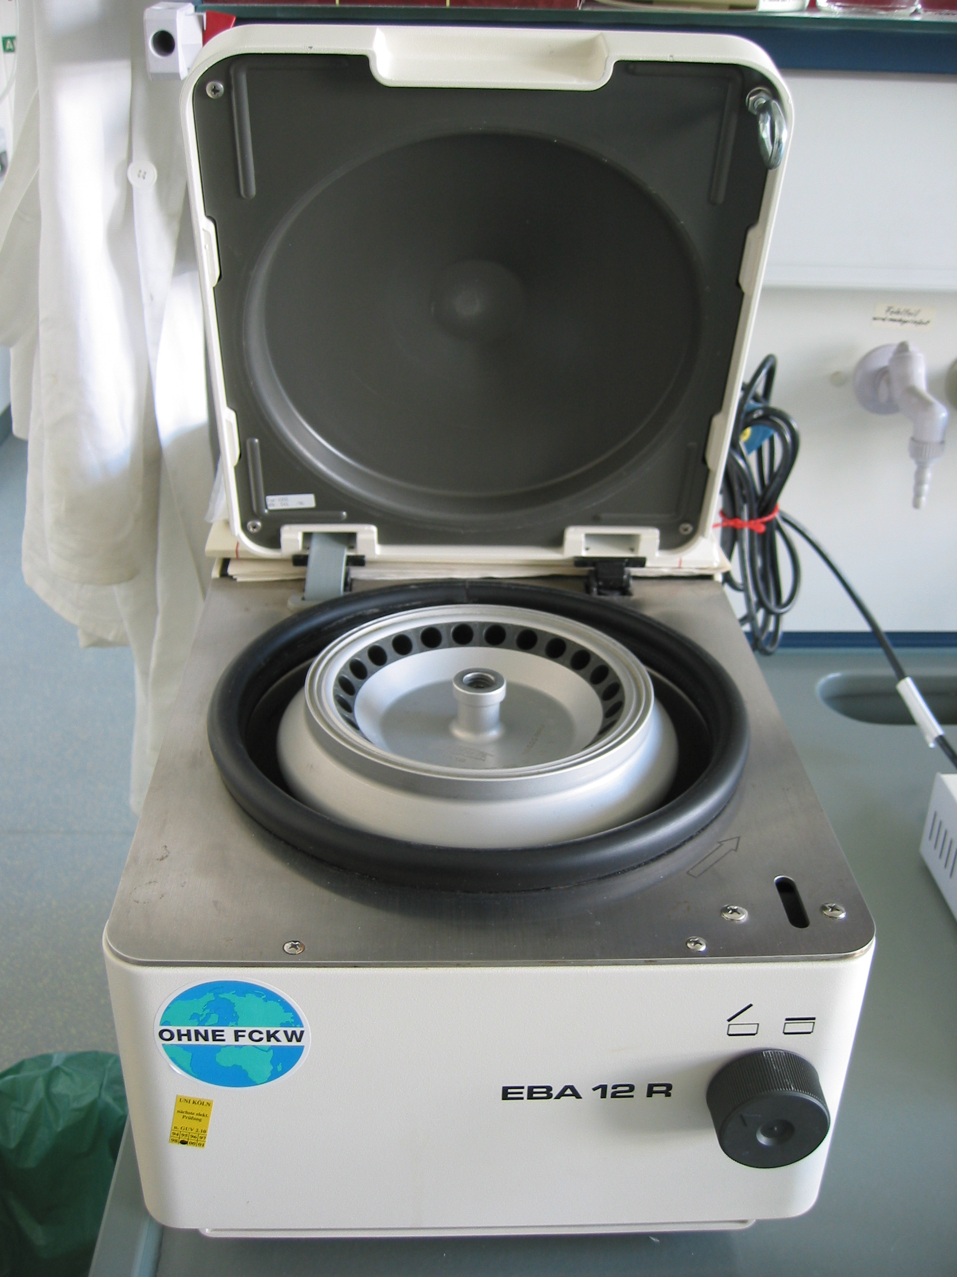

C-reactive Protein to Albumin Ratio Myocardial Infarction- Stroke Patients.
Ofordum JohnBosco C, Igbokwe Gabriel E, Ubaoji Kingsley Ikechukwu, and Ekuma Toochukwu.
Department of Applied Biochemistry, Faculty of Biosciences, Nnamdi Azikiwe University, Awka.
Department of Science Laboratory Technology, School of Science, Akanu Ibiam Federal Polytechnic Unwana.
Abstract
Materials and Methods
Results
Conclusion
My research comparing C-reactive protein to Albumin ratio myocardial infarction in stroke patients delves into the clinical collection of data of both case and control patients.
This was estimated using the Human ELISA (Enzyme linked immunosorbent assay) kit for both the case and control group.
With a focus on stroke using the case patients’ clinical data, this research links the correlation between these underlying diseases and how they contribute to myocardial infarction in middle aged men and women.
Stroke is a devastating complication .
It is a neurological disorder .
According to natures reviews on neurology, it is seen that stroke has been classified by WHO as a cardiovascular Disease.
Brain-Heart health is avery complex and divverse field of study with new ideas being developed each day through scientific research.
Age, Sex, Alcohol, smoking , high lipidemic profile/cholesterol, high blood sugar, obesity and overweight all contribute to stroke and myocardial infarction.
My fututre works for graduate school involves investigating how mental health and stress predisposes young adults to cardiovascular disease, along with recovery and rehabilitation techniques for stroke survior
40 Patients
30 Case Patients
10 Control Patients
Syringe and Methylated Spirit
Torniquet
Plain Blood Colletion Bottle
Centrifuged
Serum Bottle &Refrigerated at 4C -8C
°
°
Let,
Hypertension stand for (H) with mean age 61
Diabetes-Hypertension stand for (DH) with mean age 63.57
Stroke stand for (S) with mean age of 66.6
Diabetes stand for (D) with mean age 56.3
Case Patient findings;
Systolic and diastolic readings respectively ranging from 100-190 and 60-110mm/Hg.
CRP reference range from 2.5- 6.8
CAR Ratio= 0.785-4.400
Mean = 2.206
Standard deviation (SD) = 1.166
N:B: 60%(18 out of 30) of the patients was < than 2.206 and 40%(12 out of 30) was seen to be > than 2.206.
.
Objectives
To analyse the association of coronary artery ecstasia (CAE) and C-reactive protein albumin ratio( CAR)- in stroke patients.
Reference
ProteintechR - ptglab.com https://www.ptglab.com> elisa
Acknowledgment
To my evergreen supervisor, Dr. Igbokwe. G.E, Regina Caeli Specialist Hospital, and Ifebi Medical Center towards the completion of this work.
I would also like to honour the memory of my best friend Okoro Kingsley.
Centrifuge

